Slide 1


A Novel Generalization between Verbal Judgments and Perceptual Discrimination of 3D Space
BCS 2022572
Prachi Mahableshwarkar¹, Lindsay Houck², Dwight Kravitz¹, John Philbeck¹
¹ Psychological and Brain Sciences, The George Washington University, ² Bates College

Slide 2
Depth Perception
Notes:
Move this shpiel to the next slide, remove this slide
Strong impression of depth even from impossible scenes
In our day to day lives – we are constantly using depth information to navigate, plan, and interact with our environment.
Nowadays, we increasingly spend our time online, interfacing with data on a 2D screen. But there exists a large gap in the literature in picture perception. In the real world we have oculomotor information that helps inform our depth representation. In pictures oculomotor cues return flatness, so how do we compensate?

Slide 3

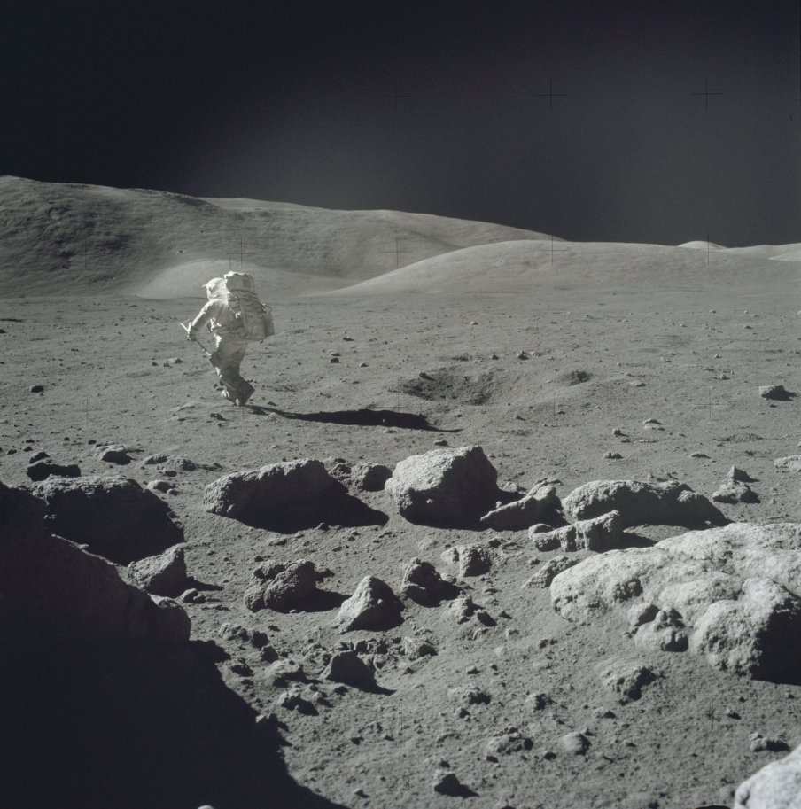
Spatial perception in pictures
Ground plane, linear perspective
Familiar size, relative size
Notes:
There is a wealth of spatial information in pictured scenes – as you can see in this beautiful painting depicting children biking on top of trees. The artist craftily manipulates the ground plane and linear perspective to create this ambiguous and mind bending visual scene.
This illusion illustrates the richness of spatial information, even in a 2D image. This shows that we can leverage pictured scenes to understand how we balance various sources of spatial information to get to a stable percent of depth.
<<have aims after this slide>>
in the absence of the right cues, we cant do this - astronaut
how do we do this?
judgemenrs are reflective os stimuli - generalization
relate data to deatures
Scene are extremely complex – we parse through a lot of information to develop a representation of depth. The interaction and abundance of information in scenes has so far prevented systematic efforts to understand depth in real world images.
This complexity and variability however is not something to shy away from. In fact, it can be leveraged to understand how we balance these various sources of information to get to a stable percept of depth over time.
Take these pieces of art for example:
The artist impressively uses pictorial depth cues to create an ambiguous and mind bending visual scene.
Bicyclists - ground plane and linear perspective
The complexity in these images has the power to reveal important interactions and information for understanding depth perception.
https://www.flickr.com/photos/119730384@N04/16600888039

Slide 4
What are the features in pictured scenes that enable depth perception?

Slide 5

Can people reliably judge distance in pictured scenes?
Experimental Paradigms
Verbal Judgment
Discrimination
Notes:
DO JUST the first question
Will use two paradigms
But we need ground truth to know so we use SUNRGBD databse → go straigt to stimulus selection slide
add a slide with the big picture question
do astronaut first
Our first aim was to test if people can reliably judge distance in pictured scenes using two canonical distance perception paradigms, that have not been use extensively in picture perception.
remove expeirmental paradigms
make the title the question
All these studies that identified these cues as facilitating depth perception, were conducted in the real world. But what happens when we only have pictorial cues available? When we view a 2D image, oculomotor cues return flatness, which changes the weighting of cues when comparing the real world to pictures.
There is a lot of heterogeneity in scenes - this means that it is unlikely that one cue is dominant across all scenes. Not to mention the differences in timing for each cue Cues are mutually constrained, and in pictures there is the added challenge of not having oculomotor cues. In pictures oculomotor cues return flatness, but we still get a sense of depth from pictures.
Pictorial cues are informative, we just don’t know the weighting and timing. That is our aim 3.
We know that extended viewing enables a depth representation that is more elaborate. In fact it could provide structure for integrating incoming information or guide attention more efficiently to informative parts of the scene.
Not all scenes have the same amount of cues, and some cues will be accessible later – so we need to be able to adapt.
I’ll discuss how we can capitalize on the complexity and diversity of these real world scenes to answer (1) how verbal estimates change over viewing durations and (2) how the relative weighting of depth cues changes over time

Slide 6

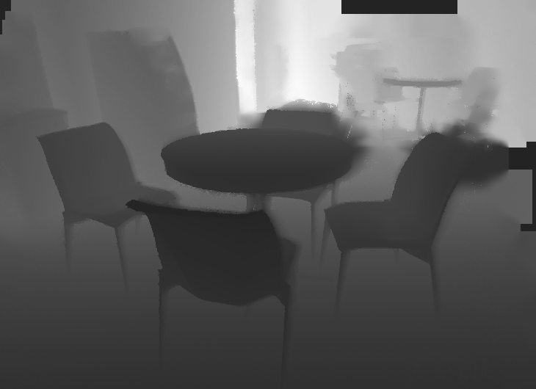

Stimuli
Target Placement
SUN-RGB D Database
Kinectv2 Depth Map
(530 x 730 matrix)
Song, S., Lichtenberg, S. P., &amp; Xiao, J. (2015)
Notes:
The Kinect depth map is used to get the ground truth depth for a high contrast target that is placed in the vertical midline of the image.
/Users/prachimahableshwarkar/Documents/GW/2019-2020/code/SUNRGBD/kv2/kinect2data/000080_2014-05-14_21-36-38_260595134347_rgbf000132-resize

Slide 7
Does behavior generalize for images across tasks?
Experimental Paradigms
Verbal Judgment
Comparative Results
Discrimination
Notes:
Does behavior vary across individual scenes and does it generalize
- Based only on stimulus
- Want to make sure behavior is not driven by task
Next we tested if behavior generalized for images across tasks and people
All these studies that identified these cues as facilitating depth perception, were conducted in the real world. But what happens when we only have pictorial cues available? When we view a 2D image, oculomotor cues return flatness, which changes the weighting of cues when comparing the real world to pictures.
There is a lot of heterogeneity in scenes - this means that it is unlikely that one cue is dominant across all scenes. Not to mention the differences in timing for each cue Cues are mutually constrained, and in pictures there is the added challenge of not having oculomotor cues. In pictures oculomotor cues return flatness, but we still get a sense of depth from pictures.
Pictorial cues are informative, we just don’t know the weighting and timing. That is our aim 3.
We know that extended viewing enables a depth representation that is more elaborate. In fact it could provide structure for integrating incoming information or guide attention more efficiently to informative parts of the scene.
Not all scenes have the same amount of cues, and some cues will be accessible later – so we need to be able to adapt.
I’ll discuss how we can capitalize on the complexity and diversity of these real world scenes to answer (1) how verbal estimates change over viewing durations and (2) how the relative weighting of depth cues changes over time

Slide 8
What is the relative utility of depth cues?
Experimental Paradigms
Verbal Judgment
Comparative Results
Depth Cues
Discrimination
Notes:
Scenes are heterogeneous - meaning the cues available in each scene will vary greatly. We can directly characterize the relative utility of depth cues by relating behavioral judgments to algorithmic quantifications of pictorial cues.
Our design capitalizes on crowd-sourced data collection pipeline and a large image database to clarify spatial information processing in pictured scenes

Slide 9
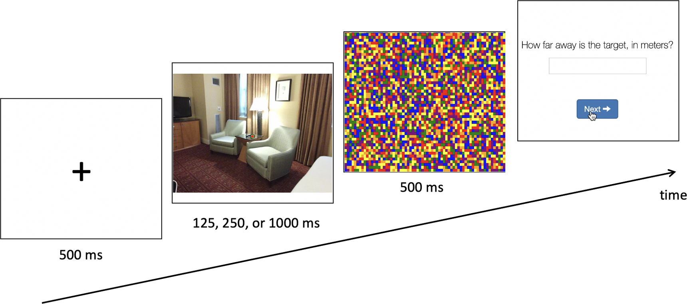

Experimental Paradigms
Verbal Judgment
N = 468, with 156 per duration
156 trials
Explicit estimate
Notes:
For the verbal judgment task people saw an image at either 125 250 or 1000 ms and were then asked ‘how far away is the target’. The duration manipulation allowed us to see how sensitivity to distance changed over time.
We employed latin square counterbalancing to control for hysteresis effects such that each participant saw a unique trial order.

Slide 10
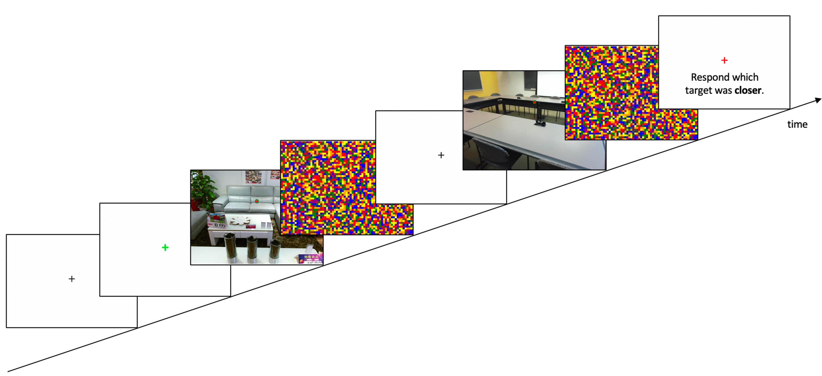
Experimental Paradigms
Verbal Judgment
N = 468, with 156 per duration
156 trials
Explicit estimate
Identical stimulus set
Matched trial orders across task
Independent participants
Discrimination
N = 468, with 156 per duration
78 trials
Keypress (‘z’ or ‘m’)
Notes:
Our discrimination paradigm was less classical. As opposed to most discrimination paradigms that have people discrimination between targets within a scene, we had people discriminate between scenes.
The two images in the discrimination trial were always unique, forcing people to create independent representations of depth for each image.
Participants responded which target was closer to them using a key press.

Slide 11
Experimental Paradigms
Verbal Judgment
N = 468, with 156 per duration
156 trials
Explicit estimate
Shared
Identical stimulus set
Independent participants, task, and duration
Discrimination
N = 468, with 156 per duration
78 trials
Keypress (‘z’ or ‘m’)
Notes:
Breakout Ns by durations )156 per duration
Because we have independent people at three durations per task, we can explicitly test generalization since ONLY the stimuli are the same
A key feature of our design was that the stimulus set was identical between tasks. We also matched trial orders across task and used independent participants to prevent preview effects.

Slide 12
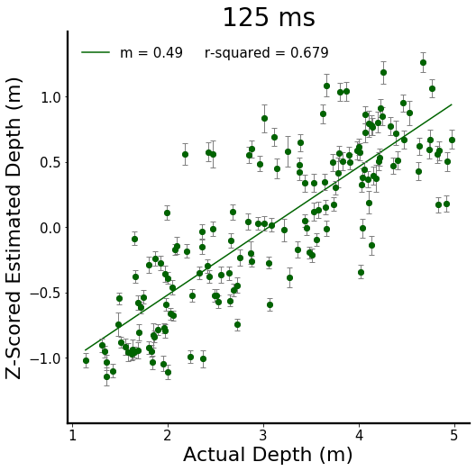
Linear Model of Individual Stimuli
Notes:
We will be looking at linear models per viewing duration. On the x axis we have actual depth, and on the y axis we have z-scored estimated depth. We took the z score of the estimates because of the variability between the range of responses given. One person might respond with depths between 1-5 meters whereas someone may overestimate overall and respond with depths between 3-12 meters. The exact numerical value of their response is not of interest however, we are more interested in how sensitive people are to changes in depth. By z-scoring we reduce the between subject variability so we can assess sensitivity.

Slide 13
Linear Model of Individual Stimuli
Notes:
This is the data at 125 ms. Each point represents the average depth estimate of 156 independent judgments for a particular scene.
We observed a slope of 0.48 with a high amount of variance explained, as seen by the r–squared value.
explain that 125 is viewing durations

Slide 14
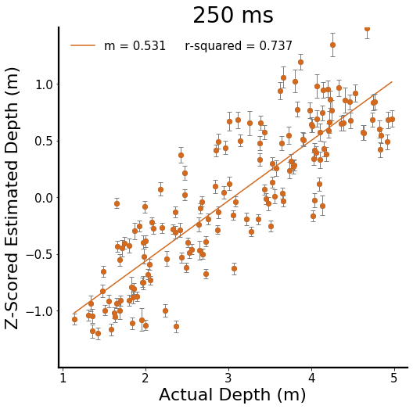
Linear Model of Individual Stimuli
Notes:
When viewing duration increases we see that the slope slightly increases as well as the variance explained by the linear model

Slide 15
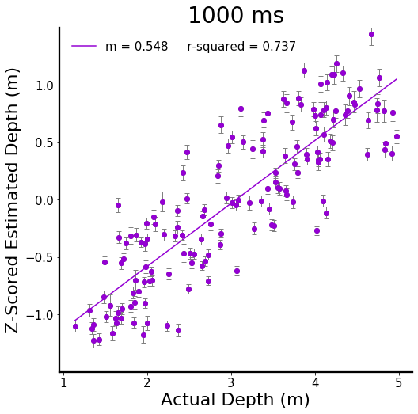
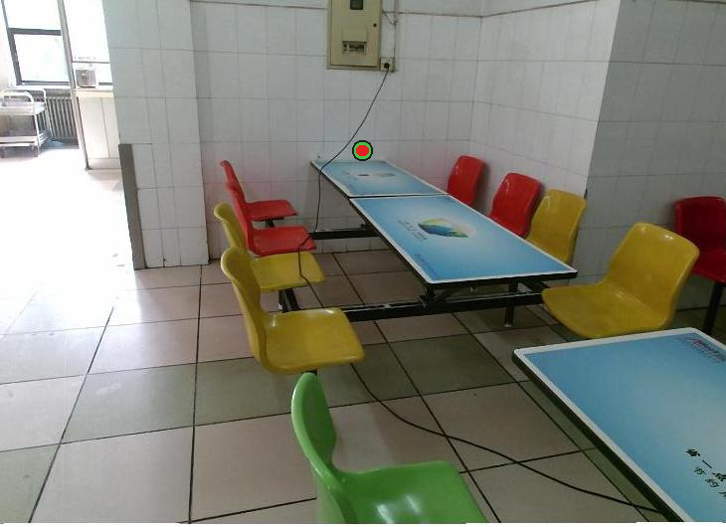
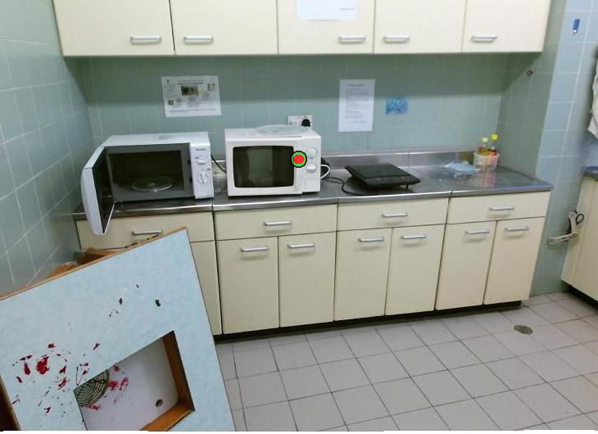
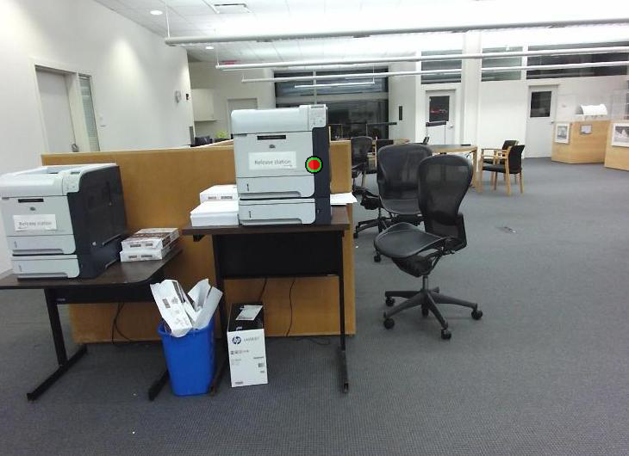
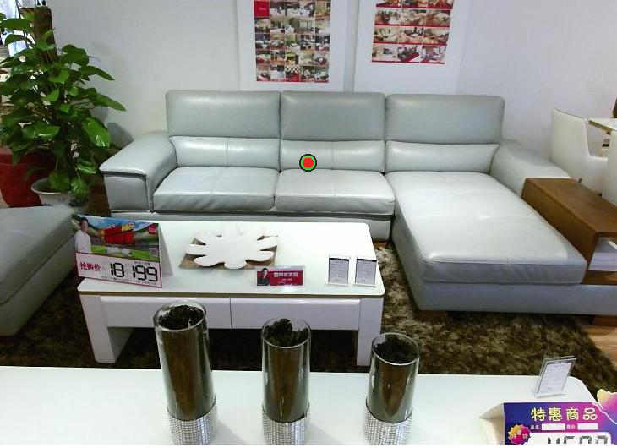
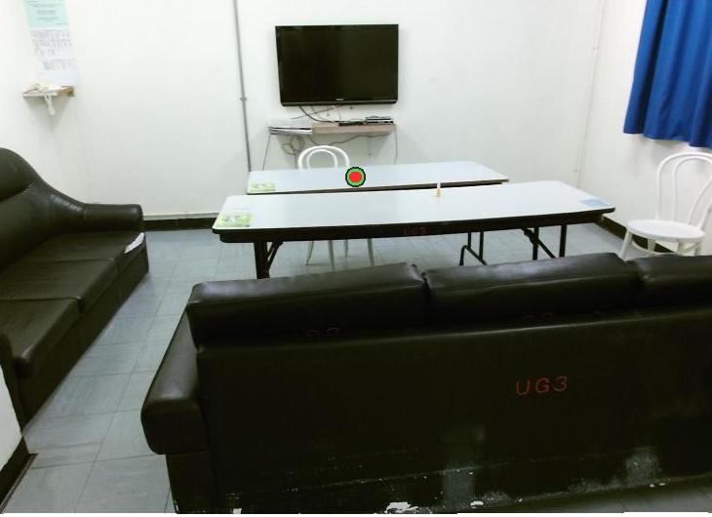
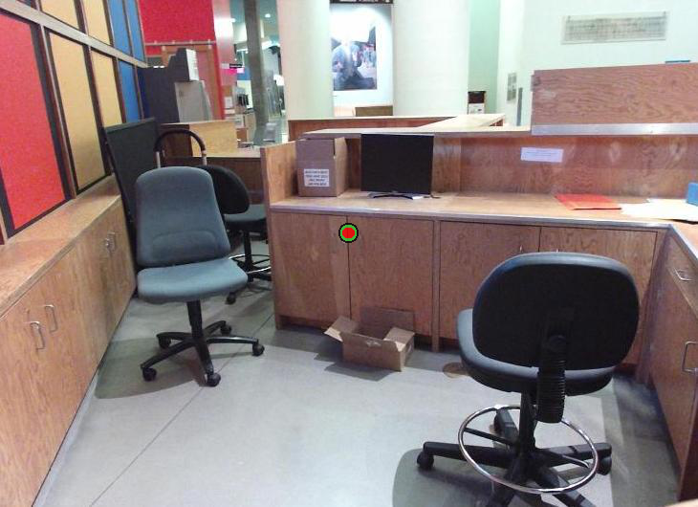
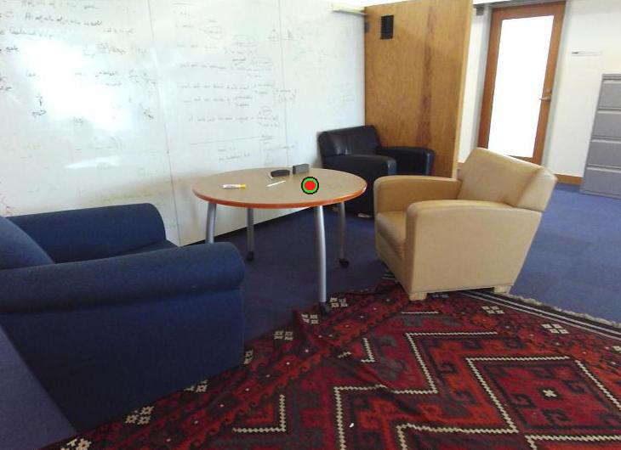
Linear Model of Individual Stimuli
Notes:
Across viewing durations we observed a numerical increase in slope – trending at 0.08
When viewing duration increases, we see that the slope slightly increases as well as the variance explained by the linear model
These linear models reveal that participants are very good at providing estimates of target depth despite the lack of depth cues that are normally available in real world environments.
In fact at as little as 125 ms significant spatial information is accessible. <SAY THIS>
Remarkably, estimates within individual scenes differed significantly from each other even at identical depths.
This suggests that variations in pictorial depth cues between scenes are in fact biasing perceptual judgments.

Slide 16
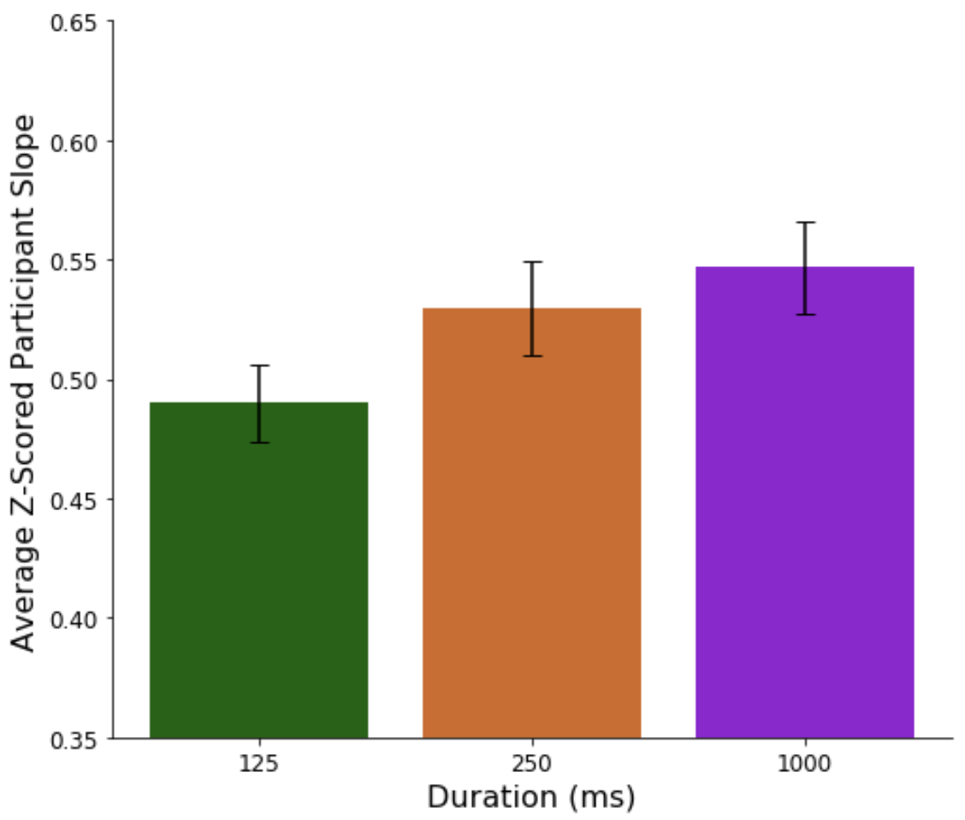
Does sensitivity to distance improve with longer viewing durations?

Slide 17
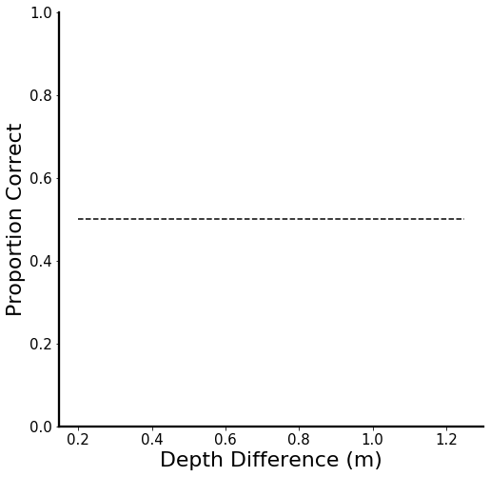
Discrimination Performance
Notes:
As a reminder, the discrimination experiment used the same stimulus set as verbal judgment and people were asked to compare target depths in different scenes and respond which target was closer to them
Relative to the difference in depth between scenes, no need to say kinect
For the plots, on the x axis we have the Kinect depth difference of the targets and on the y axis is proportion correct

Slide 18
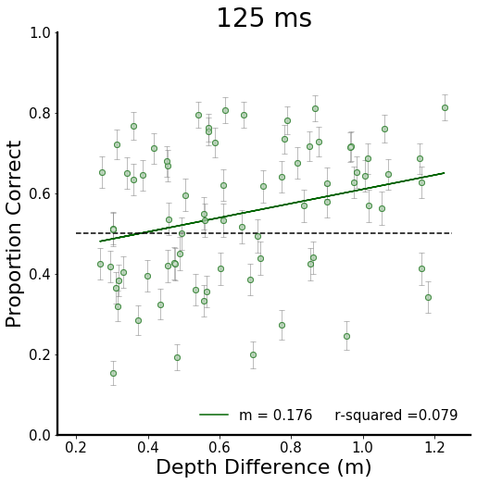
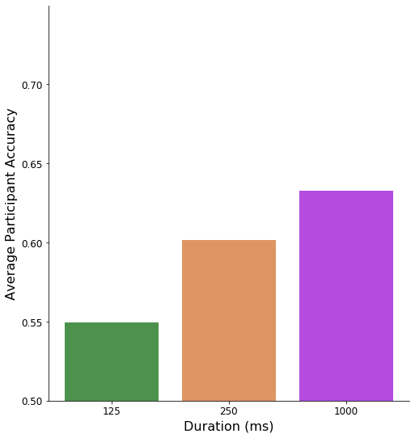
Discrimination Performance
Average Accuracy
0.55
Notes:
In general performance is above 50 percent and SHOW THE AVERAGE
Slight linear relationship between depth difference and accuracy
Weak though
At 125 ms, although we observed a significant relationship between Kinect depth difference and percent correct there were a lot of trials below chance and the variance explained by the model is quite low.

Slide 19
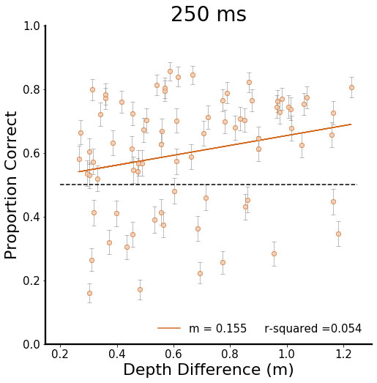
Discrimination Performance
0.60
Average Accuracy
0.55
Notes:
This pattern continued as viewing duration increased, with only slight improvements in accuracy

Slide 20
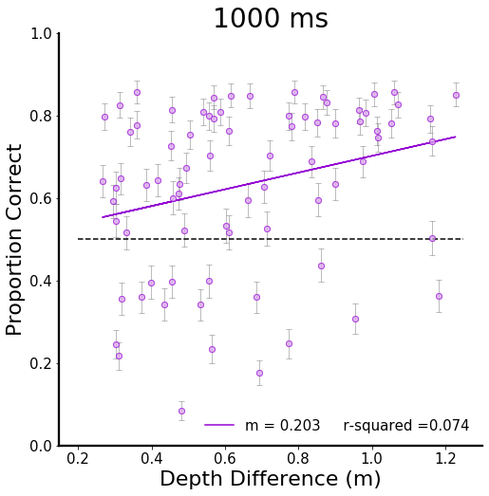
Discrimination Performance
0.63
0.60
Average Accuracy
0.55
Notes:
This pattern continued as viewing duration increased, with only slight improvements in accuracy.
Across all scenes, accuracy is abovev chance but its not great
(include accuracy paranthetically)
Now if we step back and think about a ground truth depth map – at really large depth differences we would expect to see almost ceiling accuracy since the difference should be really stark. Here however we are using smaller indoor scenes with small depth differences ranging from 0.2 meters to 1.2 meters.
At this smaller scale, experience and expectation related to the semantics of the scene may shift our depth map away from the Kinect depth map.
And we actual observed this in the verbal judgment data.

Slide 21
Verbal Judgment Linear Models
Notes:
If we look at the linear models at 125 and 250 ms in the verbal judgment data, we can zero in on the data for a particular image
Pick a better example where resid corr is dead on the line

Slide 22
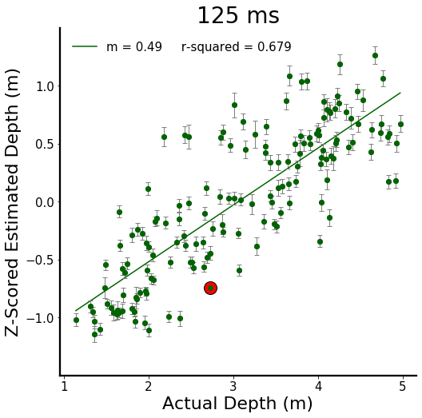
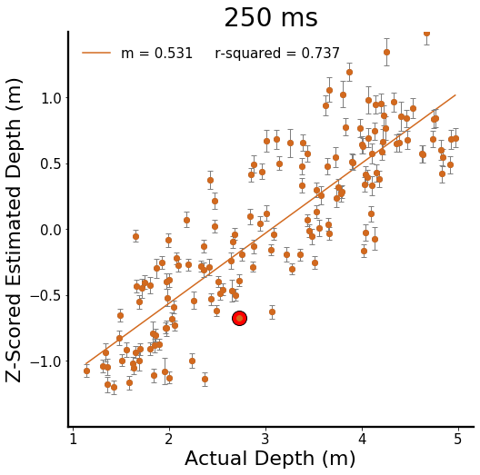
Verbal Judgment Linear Models
Notes:
This image has a relatively small standard error in both durations, but the residual or the distance from the average data point to the model prediction, is large
black cirlce is not clear in enough

Slide 23
Verbal Judgment Linear Models
Notes:
This image has a relatively small standard error in both durations, but the residual or the distance from the average data point to the model prediction, is large and seemingly quite consistent.

Slide 24
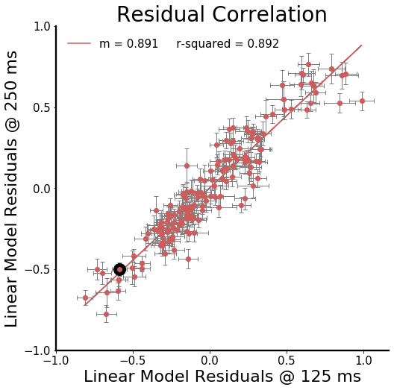
Can people reliably judge distance in individual scenes?
Notes:
And we can see this directly by correlating the model residuals at these two durations.
There is a strong correlation between these model residuals showing that people are consistent in their biases for individual images.
So we would expect discrimination not to reflect ground truth or VE
We can further probe this by regressing discrimination performance against these independent verbal estimates.

Slide 25
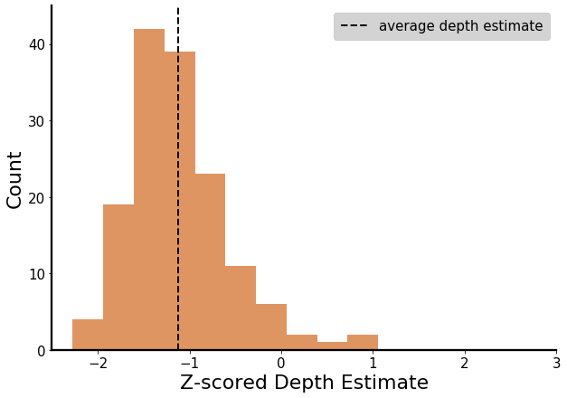
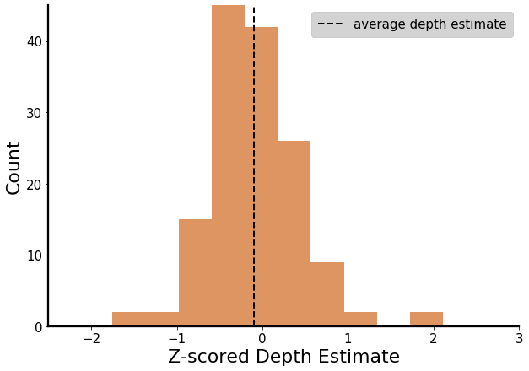
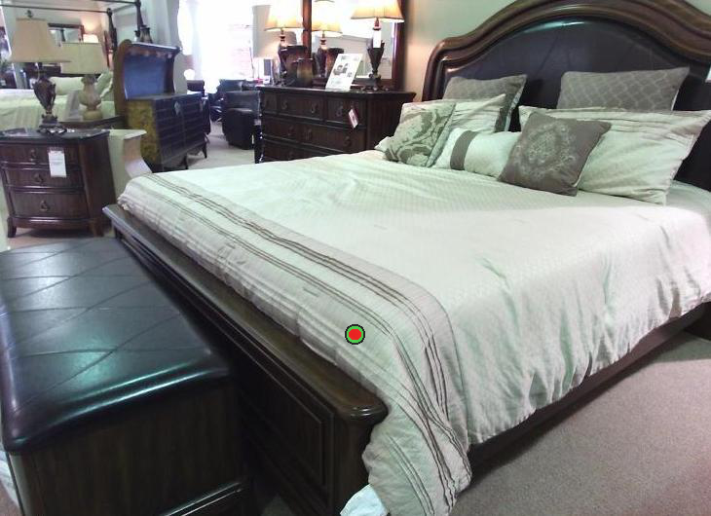
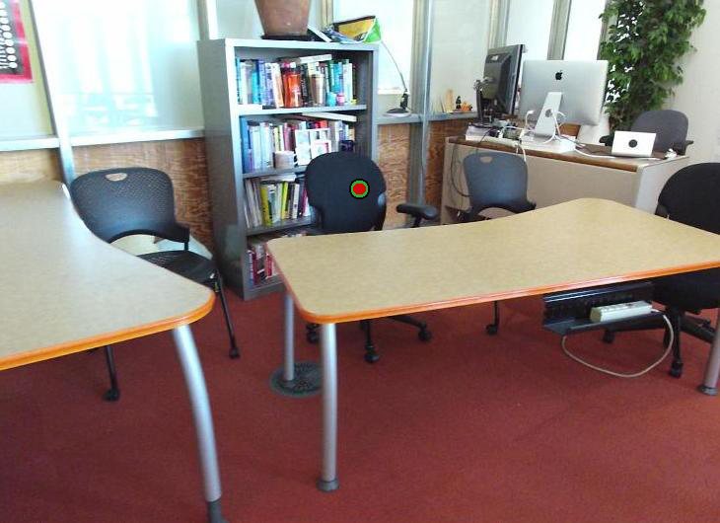
How predictable is discrimination performance from verbal judgments?
VE Stimulus 0
VE Stimulus 1
Which target was closer to you?
Notes:
Labels too small
Remove the red line
Remove box around the plot
We have distributions for each image
The question here is – how predictable is discrimination performance from independent verbal judgments?
To step through the process
1. For each the images in each discrimination trial we take a look at the distribution of verbal estimates given in experiment
2. On the left we have the distribution for stimulus 0 and on the right stimulus 1
3. Going off of the average depth estimate for each image, which is labeled with the black dashed line, if we ask the question which target was closer - the answer is stim 0
labels are too small
make the axes stand out more

Slide 26
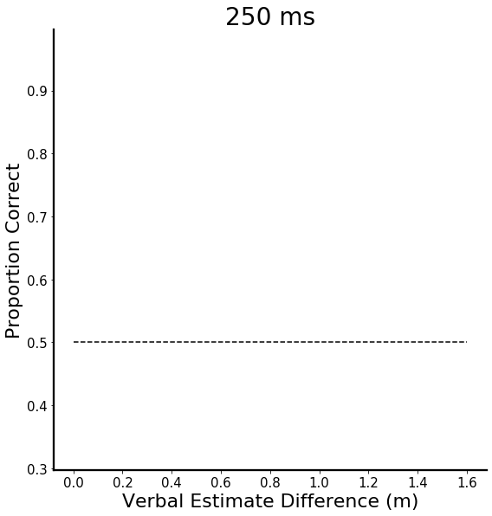
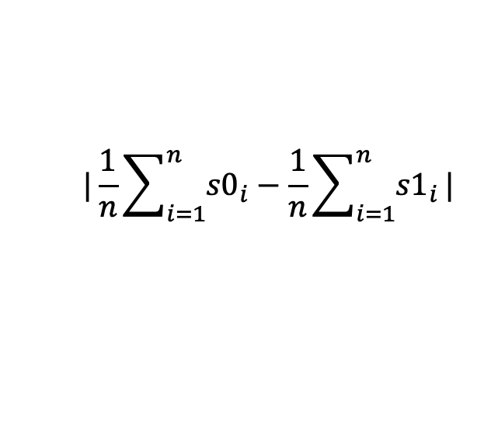
How predictable is discrimination performance from verbal judgments?
$$|\frac{1}{n}\sum_{i=1}^{n}{{s0}_{i}}−\frac{1}{n}\sum_{i=1}^{n}{{s1}_{i}}|$$
Verbal Estimate Difference =
Notes:
Scatter of Kinect depth difference and verbal estimate difference instead
- New metric on the y
- There is a relationship between the two, but there are significant deviations
- Now we can see if VE data does a better job of predicting
We did this signal detection analysis for every single trial in the discrimination data
Specifically, we took the abs value of the difference between the average z scored estimates for each image
This ‘answer key’ is then used against the discrimination data to derive percent correct
In this example we can see that at 250 ms, the accuracy is quite high for this trial

Slide 27
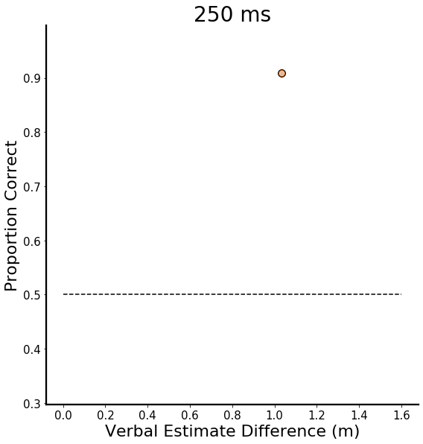
How predictable is discrimination performance from verbal judgments?
$$|\frac{1}{n}\sum_{i=1}^{n}{{s0}_{i}}−\frac{1}{n}\sum_{i=1}^{n}{{s1}_{i}}|$$
Verbal Estimate Difference =
Notes:
Scatter of Kinect depth difference and verbal estimate difference instead
- New metric on the y
- There is a relationship between the two, but there are significant deviations
- Now we can see if VE data does a better job of predicting
We did this signal detection analysis for every single trial in the discrimination data
Specifically, we took the abs value of the difference between the average z scored estimates for each image
This ‘answer key’ is then used against the discrimination data to derive percent correct
In this example we can see that at 250 ms, the accuracy is quite high for this trial

Slide 28
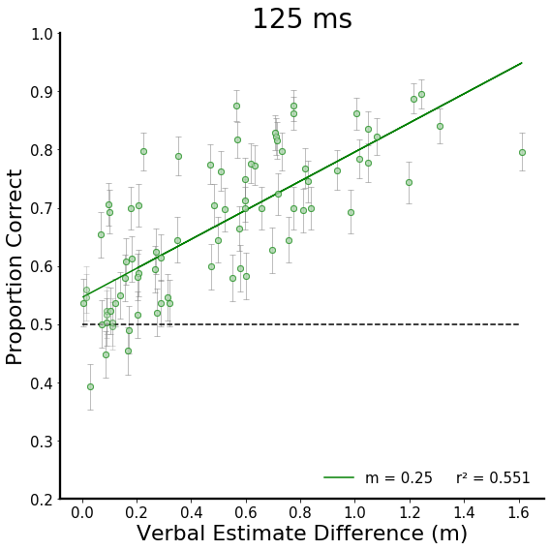
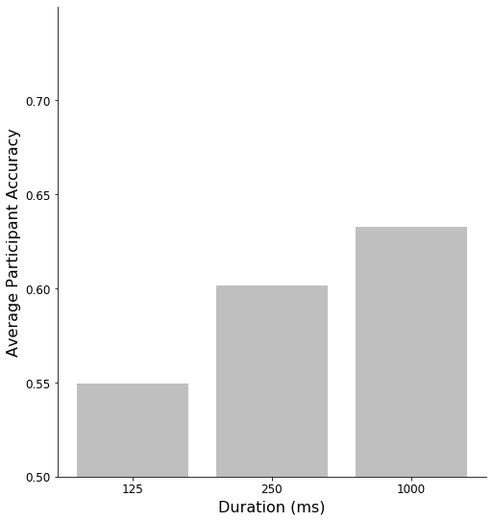
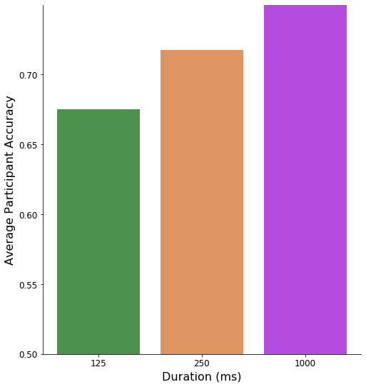
Do verbal judgments predict discrimination accuracy?
0.67
Average Accuracy
0.55
Kinect
Notes:
With this new regressor, we see a stronger model fit and an increase in accuracy overall that is sustained as viewing duration increases.
make new name for x axis
VE difference
Need to show tha average PC
do it parathetically on the title
Have the Kinect accuracy next to it to show that ve reg accuracy is better

Slide 29
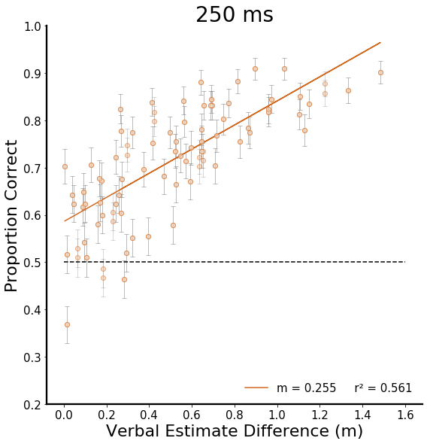
Do verbal judgments predict discrimination accuracy?
0.72
0.67
0.60
Average Accuracy
0.55
Kinect
Kinect
Notes:
With this new regressor, we see a stronger model fit and an increase in accuracy overall that is sustained as viewing duration increases.

Slide 30
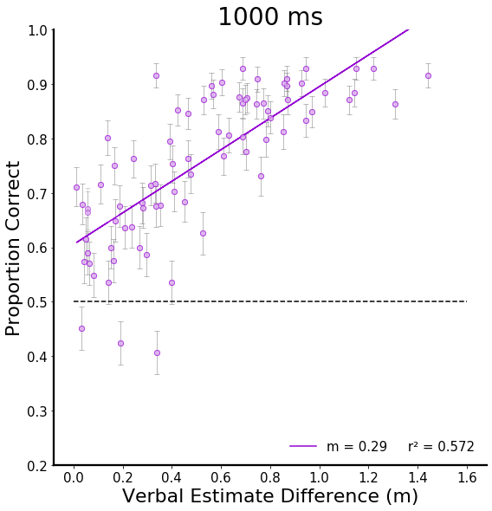
Do verbal judgments predict discrimination accuracy?
0.76
0.72
0.67
0.60
0.63
Average Accuracy
0.55
Kinect
Kinect
Kinect
Notes:
This novel relationship between the two tasks indicates that regardless of differences in task demand, people are consistent.
Additionally, we observed a main effect of duration and a significant pairwise comparison between all duration combinations, indicating that the additional viewing time improved accuracy.

Slide 31
Does behavior generalize for images across tasks?
Experimental Paradigms
Verbal Judgment
Comparative Results
Depth Cues
Discrimination
Notes:
Already started to show that there is some generalization
Broader set of interrelationships
At this point, we have observed that people can reliably judge distance in pictured scenes – so our next aim was to directly test if behavior generalizes for individual images.
There is a lot of heterogeneity in scenes - this means that it is unlikely that one cue is dominant across all scenes. Not to mention the differences in timing for each cue Cues are mutually constrained, and in pictures there is the added challenge of not having oculomotor cues. In pictures oculomotor cues return flatness, but we still get a sense of depth from pictures.
Pictorial cues are informative, we just don’t know the weighting and timing. That is our aim 3.
We know that extended viewing enables a depth representation that is more elaborate. In fact it could provide structure for integrating incoming information or guide attention more efficiently to informative parts of the scene.
Not all scenes have the same amount of cues, and some cues will be accessible later – so we need to be able to adapt.
I’ll discuss how we can capitalize on the complexity and diversity of these real world scenes to answer (1) how verbal estimates change over viewing durations and (2) how the relative weighting of depth cues changes over time

Slide 32
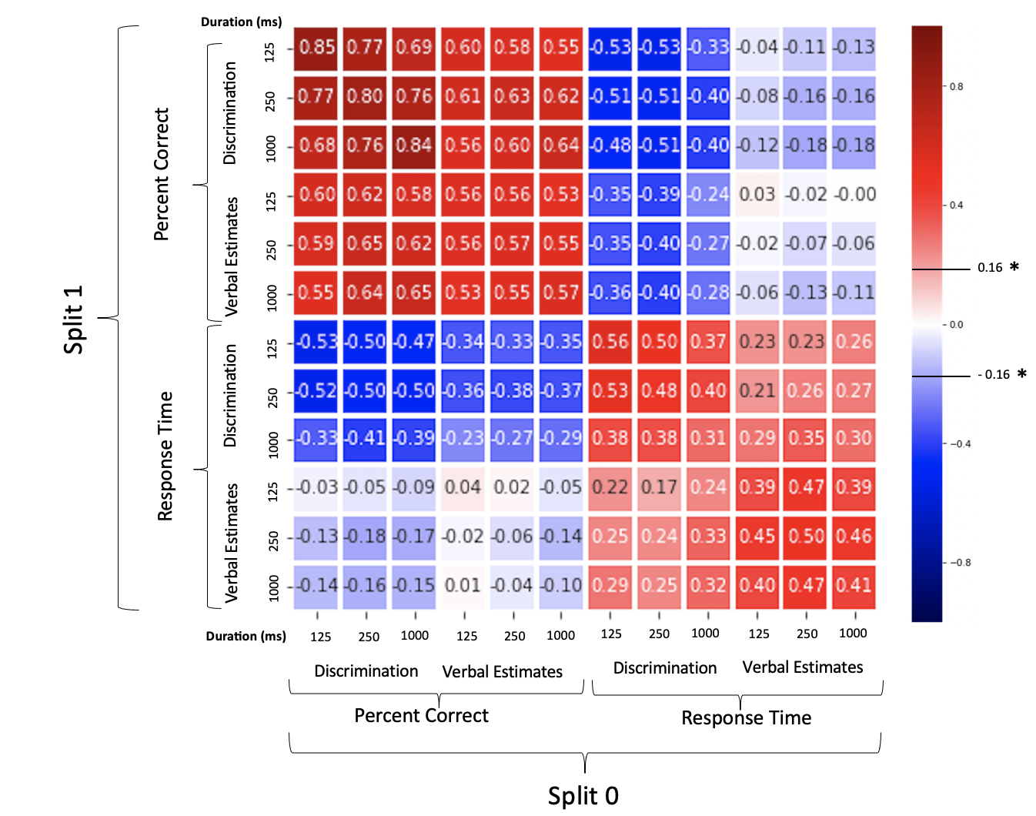
How generalizable are spatial judgments across task, duration, and outcome?
Duration (ms)
Discrimination
125
Discrimination
250
1000
Percent Correct
Verbal Estimates
125
250
Split 1
1000
Discrimination
125
Verbal Judgment
250
Response Time
1000
Verbal Estimates
Shared
125
250
1000
Verbal Estimates
Verbal Estimates
Discrimination
Discrimination
1000
Duration (ms)
125
250
1000
125
250
1000
125
250
1000
125
250
Discrimination
Percent Correct
Response Time
Split 0
Notes:
Correlation of raw data to itself
- Split data in half to see how reliable each of these metrics are
Then walk them through the data ALONG THE DIAGONAL (3x3 along the diagonal)
Discrim x Discrim
VE (derived accuracy) x VE (derived accuracy)
RT data, which I have not shown yet,
Summed response time across 2 scenes for VE
Now main diagonal is established
Then look at corr between durations and between task
Here we have a correlation matrix crossing TASK, DURATION, and OUTCOME MEASURE. We randomly split the data in each of these cells many times to recover the diagonal and better assess the reliability of the data.
This plot is the average correlation matrix across all those splits of the data.
All correlations above 0.16 are significant, but let's step through some of the most prominent effects
this is too busy
introduce the axes first
comparing
splits let us see if residuals replicate across people
just show main diagonal first
then how does it relate across duration
VE , Discrim
then RT ...
go one by one
then give a peek of the whole thing and
remove this big matrix its too much
make the takeaways the title

Slide 33
How generalizable are spatial judgments across task, duration, and outcome?
Duration (ms)
Discrimination
125
Discrimination
250
1000
Percent Correct
Verbal Estimates
125
250
Split 1
1000
Discrimination
125
Verbal Judgment
250
Response Time
1000
Verbal Estimates
Shared
125
250
1000
Verbal Estimates
Verbal Estimates
Discrimination
Discrimination
1000
Duration (ms)
125
250
1000
125
250
1000
125
250
1000
125
250
Discrimination
Percent Correct
Response Time
Split 0
Notes:
Correlation of raw data to itself
- Split data in half to see how reliable each of these metrics are
Then walk them through the data ALONG THE DIAGONAL (3x3 along the diagonal)
Discrim x Discrim
VE (derived accuracy) x VE (derived accuracy)
RT data, which I have not shown yet,
Summed response time across 2 scenes for VE
Now main diagonal is established
Then look at corr between durations and between task
Here we have a correlation matrix crossing TASK, DURATION, and OUTCOME MEASURE. We randomly split the data in each of these cells many times to recover the diagonal and better assess the reliability of the data.
This plot is the average correlation matrix across all those splits of the data.
All correlations above 0.16 are significant, but let's step through some of the most prominent effects
this is too busy
introduce the axes first
comparing
splits let us see if residuals replicate across people
just show main diagonal first
then how does it relate across duration
VE , Discrim
then RT ...
go one by one
then give a peek of the whole thing and
remove this big matrix its too much
make the takeaways the title

Slide 34
How generalizable are spatial judgments across task, duration, and outcome?
Duration (ms)
Discrimination
125
Discrimination
250
1000
Percent Correct
Verbal Estimates
125
250
Split 1
1000
Discrimination
125
Verbal Judgment
250
Response Time
1000
Verbal Estimates
Shared
125
250
1000
Verbal Estimates
Verbal Estimates
Discrimination
Discrimination
1000
Duration (ms)
125
250
1000
125
250
1000
125
250
1000
125
250
Discrimination
Percent Correct
Response Time
Split 0
Notes:
Correlation of raw data to itself
- Split data in half to see how reliable each of these metrics are
Then walk them through the data ALONG THE DIAGONAL (3x3 along the diagonal)
Discrim x Discrim
VE (derived accuracy) x VE (derived accuracy)
RT data, which I have not shown yet,
Summed response time across 2 scenes for VE
Now main diagonal is established
Then look at corr between durations and between task
Here we have a correlation matrix crossing TASK, DURATION, and OUTCOME MEASURE. We randomly split the data in each of these cells many times to recover the diagonal and better assess the reliability of the data.
This plot is the average correlation matrix across all those splits of the data.
All correlations above 0.16 are significant, but let's step through some of the most prominent effects
this is too busy
introduce the axes first
comparing
splits let us see if residuals replicate across people
just show main diagonal first
then how does it relate across duration
VE , Discrim
then RT ...
go one by one
then give a peek of the whole thing and
remove this big matrix its too much
make the takeaways the title

Slide 35
How generalizable are spatial judgments across task, duration, and outcome?
Discrimination
125
Discrimination
250
1000
Percent Correct
Verbal Estimates
125
250
Split 1
1000
Discrimination
125
Verbal Judgment
250
Response Time
1000
Verbal Estimates
Shared
125
250
1000
Verbal Estimates
Verbal Estimates
Discrimination
Discrimination
1000
125
250
1000
125
250
1000
125
250
1000
125
250
Discrimination
Percent Correct
Response Time
Split 0
Notes:
Correlation of raw data to itself
- Split data in half to see how reliable each of these metrics are
Then walk them through the data ALONG THE DIAGONAL (3x3 along the diagonal)
Discrim x Discrim
VE (derived accuracy) x VE (derived accuracy)
RT data, which I have not shown yet,
Summed response time across 2 scenes for VE
Now main diagonal is established
Then look at corr between durations and between task
Here we have a correlation matrix crossing TASK, DURATION, and OUTCOME MEASURE. We randomly split the data in each of these cells many times to recover the diagonal and better assess the reliability of the data.
This plot is the average correlation matrix across all those splits of the data.
All correlations above 0.16 are significant, but let's step through some of the most prominent effects
this is too busy
introduce the axes first
comparing
splits let us see if residuals replicate across people
just show main diagonal first
then how does it relate across duration
VE , Discrim
then RT ...
go one by one
then give a peek of the whole thing and
remove this big matrix its too much
make the takeaways the title

Slide 36
Within task accuracy is highly reliable
Discrimination
125
250
1000
Verbal Estimates
125
250
1000
Discrimination
125
Verbal Judgment
250
1000
Verbal Estimates
Shared
125
250
1000
Verbal Estimates
Verbal Estimates
Discrimination
Discrimination
1000
Duration (ms)
125
250
1000
125
250
1000
125
250
1000
125
250
Discrimination
Notes:
Within the discrimination data, accuracy is highly reliable across random splits and between viewing durations.

Slide 37
Within task accuracy is highly reliable
Discrimination
125
250
1000
Verbal Estimates
125
250
1000
Discrimination
125
Verbal Judgment
250
1000
Verbal Estimates
Shared
125
250
1000
Verbal Estimates
Verbal Estimates
Discrimination
Discrimination
1000
Duration (ms)
125
250
1000
125
250
1000
125
250
1000
125
250
Discrimination
Notes:
We see this for the verbal judgment data as well.

Slide 38
Within task reaction time is highly reliable
Discrimination
125
250
1000
Verbal Estimates
125
250
1000
Discrimination
125
Verbal Judgment
250
1000
Verbal Estimates
Shared
125
250
1000
Verbal Estimates
Verbal Estimates
Discrimination
Discrimination
1000
Duration (ms)
125
250
1000
125
250
1000
125
250
1000
125
250
Discrimination
Notes:
We see this for the verbal judgment data as well.

Slide 39
Within task reaction time is highly reliable
Discrimination
125
250
1000
Verbal Estimates
125
250
1000
Discrimination
125
Verbal Judgment
250
1000
Verbal Estimates
Shared
125
250
1000
Verbal Estimates
Verbal Estimates
Discrimination
Discrimination
1000
Duration (ms)
125
250
1000
125
250
1000
125
250
1000
125
250
Discrimination
Notes:
We see this for the verbal judgment data as well.

Slide 40
Within task reaction time is highly reliable
Discrimination
125
Task can be decoded using accuracy and RT correlations
250
1000
Verbal Estimates
125
250
1000
Discrimination
125
Verbal Judgment
250
1000
Verbal Estimates
Shared
125
250
1000
Verbal Estimates
Verbal Estimates
Discrimination
Discrimination
1000
Duration (ms)
125
250
1000
125
250
1000
125
250
1000
125
250
Discrimination
Notes:
We see this for the verbal judgment data as well.

Slide 41
Accuracy and reaction time generalize between tasks
Discrimination
125
250
1000
Verbal Estimates
125
250
1000
Discrimination
125
Verbal Judgment
250
1000
Verbal Estimates
Shared
125
250
1000
Verbal Estimates
Verbal Estimates
Discrimination
Discrimination
1000
Duration (ms)
125
250
1000
125
250
1000
125
250
1000
125
250
Discrimination
Notes:
Most fascinating however is the strong correlations in accuracy between tasks – demonstrating consistent biases across tasks for individual stimuli.
Task demand is very different and yet people remain consistent – demonstrating that results are truly a result of spatial processing

Slide 42
Accuracy and reaction time generalize between tasks
Discrimination
125
250
1000
Verbal Estimates
125
Systematic errors and biases between tasks
for individual stimuli
250
1000
Discrimination
125
Verbal Judgment
250
1000
Verbal Estimates
Shared
125
250
1000
Verbal Estimates
Verbal Estimates
Discrimination
Discrimination
1000
Duration (ms)
125
250
1000
125
250
1000
125
250
1000
125
250
Discrimination
Notes:
Most fascinating however is the strong correlations in accuracy between tasks – demonstrating consistent biases across tasks for individual stimuli.
Task demand is very different and yet people remain consistent – demonstrating that results are truly a result of spatial processing

Slide 43
Response time from discrimination reliably predicts verbal judgment accuracy
Discrimination
125
250
1000
Verbal Estimates
125
250
1000
Discrimination
125
Verbal Judgment
250
1000
Verbal Estimates
Shared
125
250
1000
Verbal Estimates
Verbal Estimates
Discrimination
Discrimination
1000
Duration (ms)
125
250
1000
125
250
1000
125
250
1000
125
250
Discrimination
Notes:
Before I put this up
If there was a speed accuracy tradeoff we would see a positive corr
But what we see is a NEG correlation suggesting that people are faster and more accuracy for certain discrirminations than others
One of the most compelling findings however is in this 3x3 matrix, which shows that response time from discrimination can reliably predict verbal judgment accuracy.

Slide 44
Response time from discrimination reliably predicts verbal judgment accuracy
Discrimination
125
250
1000
Verbal Estimates
125
250
1000
Discrimination
125
Verbal Judgment
250
Stimulus driven generalization between task, duration, and outcome measure
1000
Verbal Estimates
Shared
125
250
1000
Verbal Estimates
Verbal Estimates
Discrimination
Discrimination
1000
Duration (ms)
125
250
1000
125
250
1000
125
250
1000
125
250
Discrimination
Notes:
Before I put this up
If there was a speed accuracy tradeoff we would see a positive corr
But what we see is a NEG correlation suggesting that people are faster and more accuracy for certain discrirminations than others
One of the most compelling findings however is in this 3x3 matrix, which shows that response time from discrimination can reliably predict verbal judgment accuracy.

Slide 45
What is the relative utility of depth cues?
Experimental Paradigms
Verbal Judgment
Comparative Results
Depth Cues
Discrimination
Notes:
we can use all this behavioral data to understand the relative utility of pictorial cues by tracking how behavior changes along variations in scene image features.
To do this we need to calculate these cue values in a systematic way.

Slide 46
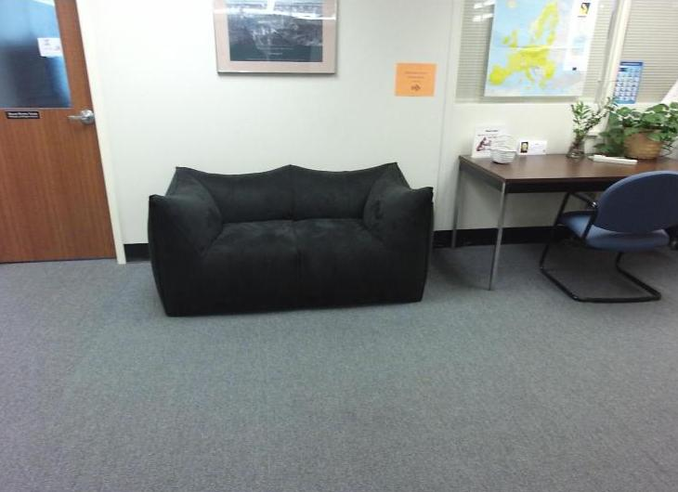
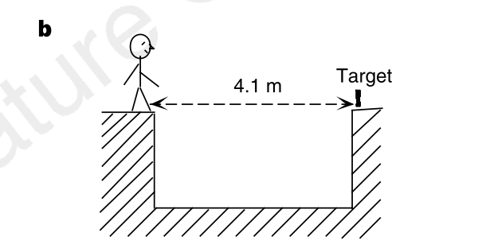
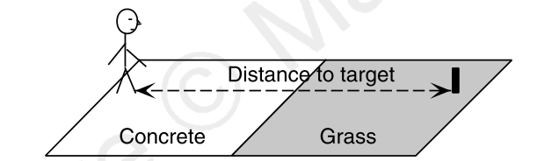
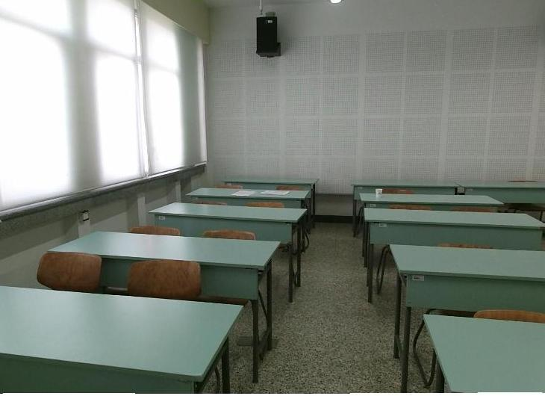
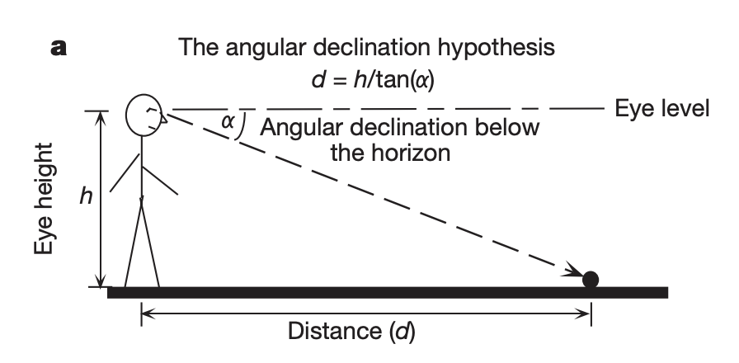
Relative Depth Cues
Visible Ground Plane
Texture Gradient
Relative Size
Angular Declination
Familiar Size
Notes:
These are the cues that have been tested in real world scenes
People are not only capable of picking up relative depth, but they can produce reasonable estimates of absolute depth
Familiar size is important here
We have developed an algorithmic approach to quantifying cues such as those listed here, which widely vary in our database of images.
<that we are working to complete so that we can directly test for the utility of each cue in our set of selected scenes.>

Slide 47
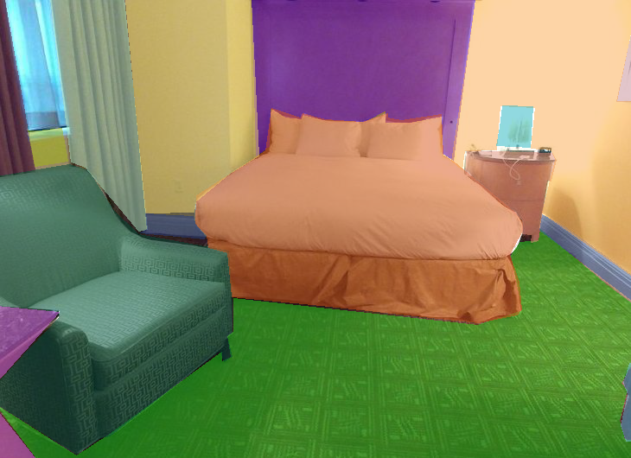
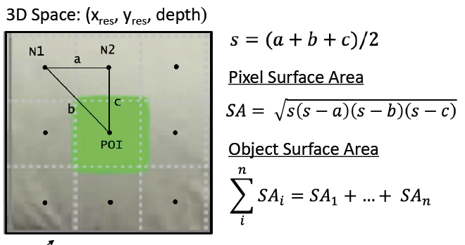
Surface Area
4.41 m²
2.64 m²
9.82 m²
1.76 m²
4.58 m²
7.95 m²
Notes:
Specifically, we have developed an algorithm that recovers the real world dimensions of each pixel and calculates the surface area of each pixel in the image, resulting in output like this
With a measure of size for each object we can assess the impact of the ground plane, familiar size, and many other cues.
We hope to produce

Slide 48
How far away is the hill behind the astronaut?
Notes:
In comparison to our stimuli, if we go back to our astronaut example
We have so little semantic information
All of us, im assuming, are unfamiliar with the moon and have no reference frame for the familiar size of these objects – so id guess there would be a lot of variability in responses.
But I hope I have convinced you that this variabililty and error is at the crux of understanding human spatial perception. It is therefore critical that we test spatial perception in scenes that we navigate on a daily basis so we can predict errors that may be made.

Slide 49
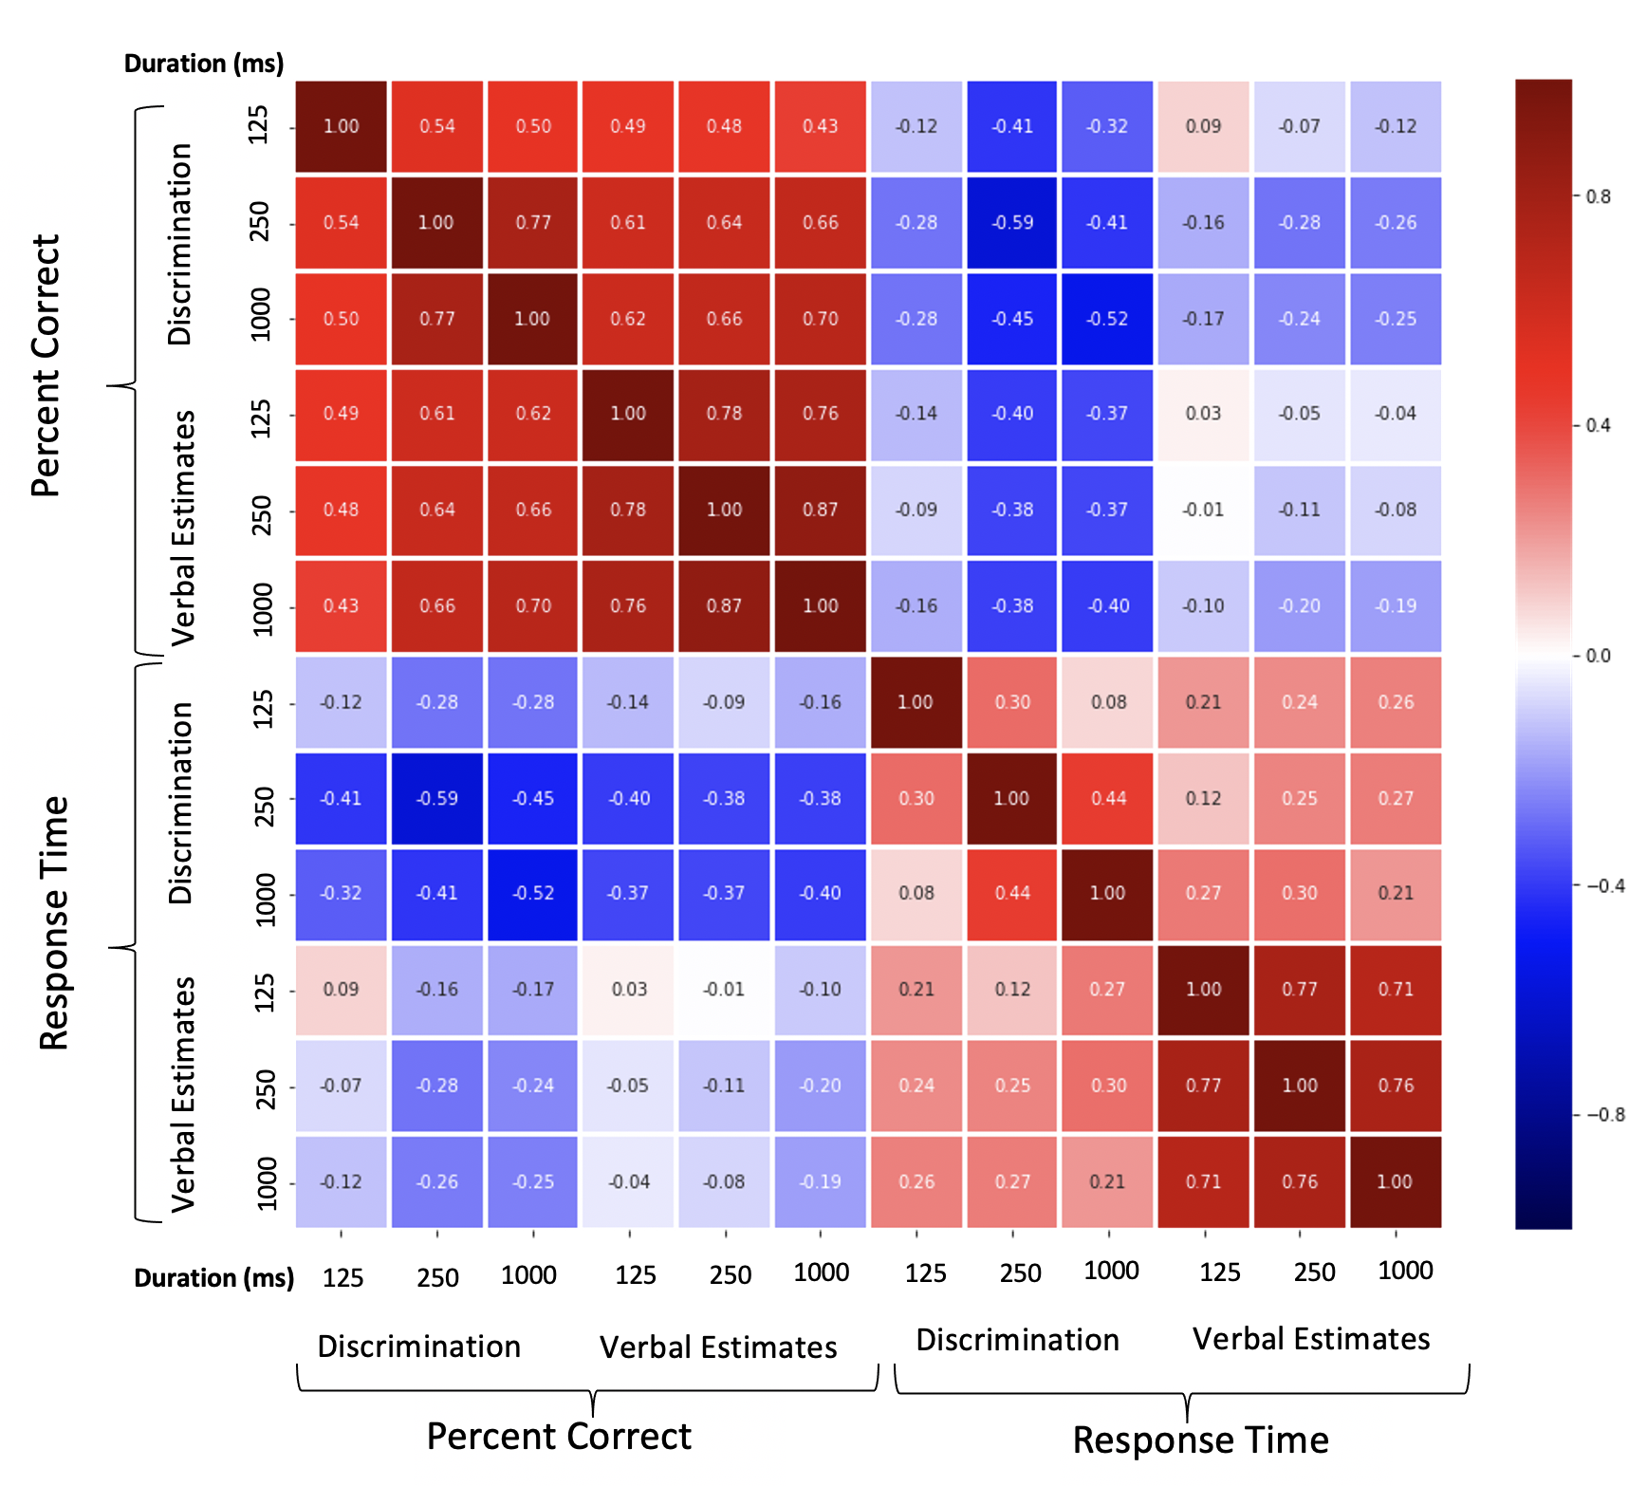
Spatial perception in pictures is precise and systematically biased by features in pictured scenes
Behavioral Data
Verbal Judgment
Comparative Results
Discrimination
Notes:
This is precisely why we need this quantification of behavior in multiple tasks, paired with unbiased, algorithmic quantifications of depth cues.
Depth perception is linked to our Ability to localize objects in the environment → navigation, reaching, throwing, grasping
Requires reliable and stable percept of depth
Basic science: important to understand the information processing behind depth perception
Applications:
Training (VR, military)
Clinical and applied settings – occupations where people have to interface with data to make rapid depth judgements
HCI
Understanding the depth perception mechanism can enable us to optimize trainings as well as human interfaces for accurate depth judgements
In the real world, we do not always get a long glimpse of our environment. We encounter fast moving situations that require a speeded perception of time.
Speed of processing can also decline with age, or neurological problems.
For these reasons knowing how people generally process spatial information over time is of interest.
Interaction and abundance of cues has prevented systematic efforts to understand depth judgements in real world scenes
In the real world we dont always get a long glimpse, fast moving situations, or aging affects that affect speed of processing Knowing about ow people can process spatial info over time is of use bc sometimes we only get brief glimpse Some cues prob come immediately Others take longer to come in Timecourse of individual cues
ERRORS CAN BE MADE WHEN YOU DON’T HAVE A LOT OF TIME – SO WE WANT TO QUANITYF, UNDERSTAND AND PREDICT THOSE ERRORS – FAST MOVING ISTUATION LIKE TRAFFIC OR BE MULTITASKING, HIGH COGNITIVE LOAD, NEURLOGICAL DISORDERS, AGE ETC.

Slide 50
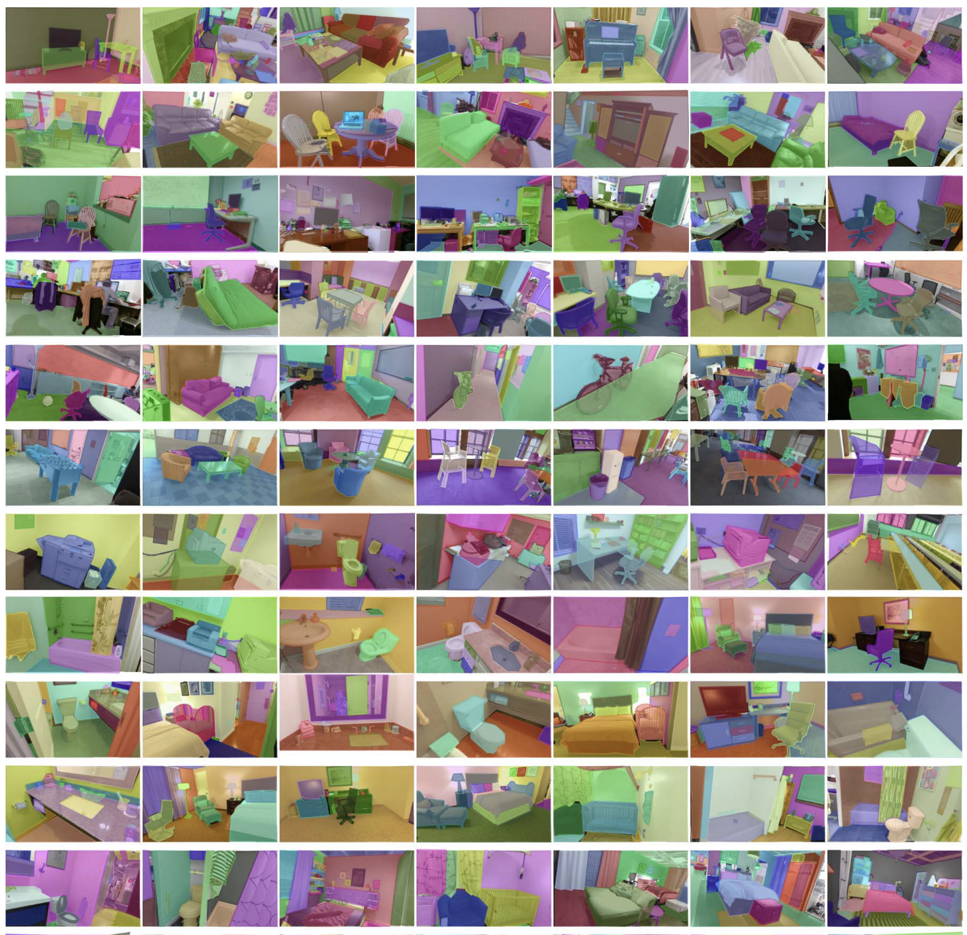
Spatial perception in pictures is precise and systematically biased by features in pictured scenes
Quantification of Pictorial Cues
Behavioral Data
+
Image N = [ground plane, relative size, clutter, …]
Verbal Judgment
Comparative Results
Depth Cues
Discrimination
Notes:
This is precisely why we need this quantification of behavior in multiple tasks, paired with unbiased, algorithmic quantifications of depth cues.
Depth perception is linked to our Ability to localize objects in the environment → navigation, reaching, throwing, grasping
Requires reliable and stable percept of depth
Basic science: important to understand the information processing behind depth perception
Applications:
Training (VR, military)
Clinical and applied settings – occupations where people have to interface with data to make rapid depth judgements
HCI
Understanding the depth perception mechanism can enable us to optimize trainings as well as human interfaces for accurate depth judgements
In the real world, we do not always get a long glimpse of our environment. We encounter fast moving situations that require a speeded perception of time.
Speed of processing can also decline with age, or neurological problems.
For these reasons knowing how people generally process spatial information over time is of interest.
Interaction and abundance of cues has prevented systematic efforts to understand depth judgements in real world scenes
In the real world we dont always get a long glimpse, fast moving situations, or aging affects that affect speed of processing Knowing about ow people can process spatial info over time is of use bc sometimes we only get brief glimpse Some cues prob come immediately Others take longer to come in Timecourse of individual cues
ERRORS CAN BE MADE WHEN YOU DON’T HAVE A LOT OF TIME – SO WE WANT TO QUANITYF, UNDERSTAND AND PREDICT THOSE ERRORS – FAST MOVING ISTUATION LIKE TRAFFIC OR BE MULTITASKING, HIGH COGNITIVE LOAD, NEURLOGICAL DISORDERS, AGE ETC.

Slide 51
Spatial perception in pictures is precise and systematically biased by features in pictured scenes
Quantification of Pictorial Cues
Behavioral Data
+
=
Generalizable Model of Spatial Information Understanding in Pictured Scenes
Image N = [ground plane, relative size, clutter, …]
Verbal Judgment
Comparative Results
Depth Cues
Discrimination
Notes:
We have computer models that can generate accurate depth maps – but now we have the capability to develop a model that represents human spatial perception, including our biases so that we can predict error reliably.
In fact, this method can be used to test any number of global or local scene features in any number of scenes, giving us important insight into human visual perception.
Lots of human models use data from ideal conditions, which do not generalize as well to other contexts
Since we are using brief glimpse at various durations, our models account for varying levels of difficulty
Many models characterize representations specific to a task
Our model is resilient to difference in task demand
Characterization of human error
Flexible framework for quantifying and predicting error that can be translated to evaluating population differences (autism, age, gender) and different perceptual tasks
Depth perception is linked to our Ability to localize objects in the environment → navigation, reaching, throwing, grasping
Requires reliable and stable percept of depth
Basic science: important to understand the information processing behind depth perception
Applications:
Training (VR, military)
Clinical and applied settings – occupations where people have to interface with data to make rapid depth judgements
HCI
Understanding the depth perception mechanism can enable us to optimize trainings as well as human interfaces for accurate depth judgements
In the real world, we do not always get a long glimpse of our environment. We encounter fast moving situations that require a speeded perception of time.
Speed of processing can also decline with age, or neurological problems.
For these reasons knowing how people generally process spatial information over time is of interest.
Interaction and abundance of cues has prevented systematic efforts to understand depth judgements in real world scenes
In the real world we dont always get a long glimpse, fast moving situations, or aging affects that affect speed of processing Knowing about ow people can process spatial info over time is of use bc sometimes we only get brief glimpse Some cues prob come immediately Others take longer to come in Timecourse of individual cues
ERRORS CAN BE MADE WHEN YOU DON’T HAVE A LOT OF TIME – SO WE WANT TO QUANITYF, UNDERSTAND AND PREDICT THOSE ERRORS – FAST MOVING ISTUATION LIKE TRAFFIC OR BE MULTITASKING, HIGH COGNITIVE LOAD, NEURLOGICAL DISORDERS, AGE ETC.

Slide 52



Thank you!
Dwight Kravitz
John Philbeck
Lindsay Houck
GWU Brain and Navigation Lab
NSF Behavioral and Cognitive Sciences 2022572
pmahable@gwu.edu

Slide 53
Archive

Slide 54
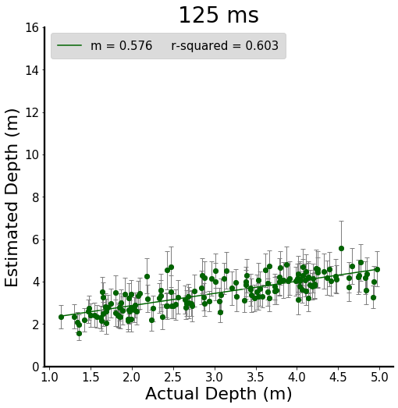
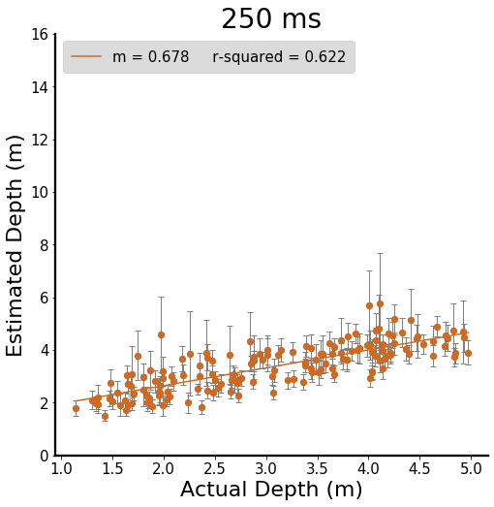
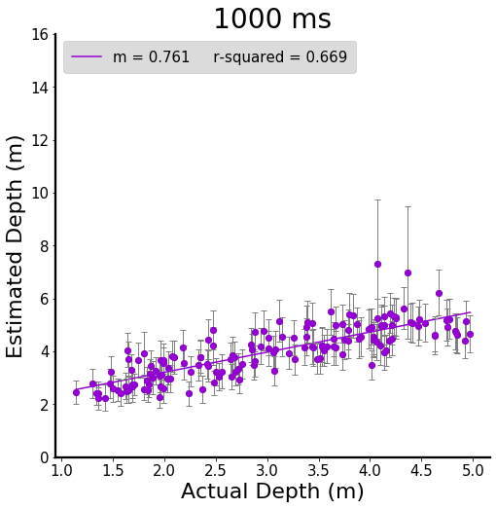
Verbal Judgment: Raw Data

Slide 55
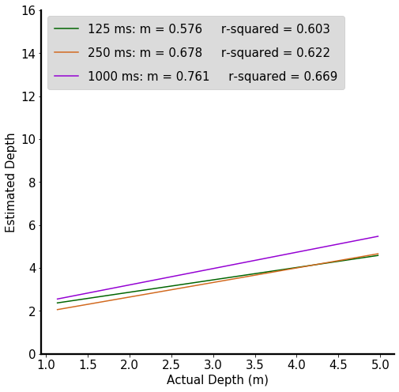
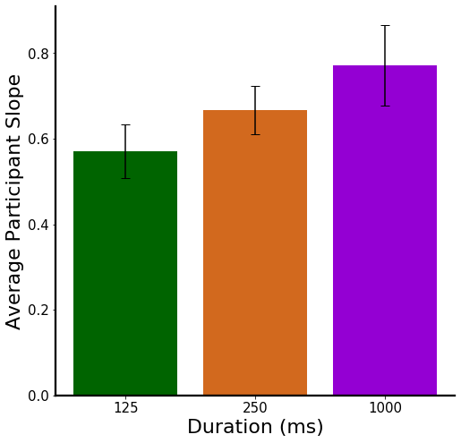
Verbal Judgment: Raw Data

Slide 56

Age: Verbal Judgment Data

Slide 57

Age: Verbal Judgment Data

Slide 58

Age: Verbal Judgment Data

Slide 59

Age: Verbal Judgment Data

Slide 60

Gender: Verbal Judgment Data

Slide 61


Gender: Verbal Judgment Data

Slide 62


Gender: Raw Verbal Judgment Data

Slide 63

Gender: Discrimination

Slide 64

Gender: Discrimination

Slide 65

Gender: Discrimination

Slide 66

Do independent verbal judgments predict discrimination reaction time?

Slide 67

Do independent verbal judgments predict discrimination reaction time?

Slide 68




Do independent verbal judgments predict discrimination reaction time?
$$∗∗∗$$
$$∗∗∗$$
$$∗∗∗$$
Note: Pairwise duration independent t-tests
*** Indicates p < 0.001

Slide 69



Is discrimination accuracy related to the average verbal estimate of the targets?

Slide 70
How far away is the hill behind the astronaut?
Notes:
To further emphasize the importance of these cues, consider this question – how far away is the hill behind the astronaut?
There are a lot of factors working against you when I pose this question
This is a picture so oculomotor cues are returning flatness, they are essentially uninformative
So you are forced to rely only on pictorial cues – unfortunately there is very little familiar size information, making it very hard to estimate depth
Hill on background is miles away, but its very hard to tell that given the information you have from pictorial cues.
All this to say – the biases we have and errors we make when we encounter scenes are at the crux of our understanding of human depth perception.
This is why quantifying the information in a given scene is very important. Particularly in pictures of real world scenes that we navigate in and interact with on a day to day basis.

Slide 71

What cues facilitate depth perception in natural environments?
Visible Ground Plane
Texture Gradient
Relative Size
Angular Declination
Familiar Size
Notes:
Familiar size
Take this car for example - we are all experienced enough with cars to know the general size of a car. If the retinal size of the object is different than what you know, this can indicate distance.
If we know how big an object is, then trigonometrically we are able to come to distance
------------------------------------------------------------------------------------------------------------------------------------------------------------------------------------------------------------------------------------------------------------------------
Tan (opp/adj)
Opposite is the linear isze, and adjacent is the distance
Linear size is familiar size, so we can recover the distance
If I know how big it is, angular size, then I can calculate the distance

Slide 72
What cues facilitate depth perception in natural environments?
Visible Ground Plane
Texture Gradient
Relative Size
Angular Declination
Familiar Size
Notes:
Familiar size
Take this car for example - we are all experienced enough with cars to know the general size of a car. If the retinal size of the object is different than what you know, this can indicate distance.
If we know how big an object is, then trigonometrically we are able to come to distance
------------------------------------------------------------------------------------------------------------------------------------------------------------------------------------------------------------------------------------------------------------------------
Tan (opp/adj)
Opposite is the linear isze, and adjacent is the distance
Linear size is familiar size, so we can recover the distance
If I know how big it is, angular size, then I can calculate the distance

Slide 73
What cues facilitate depth perception in natural environments?
Visible Ground Plane
Texture Gradient
Relative Size
Notes:
Familiar size
Take this car for example - we are all experienced enough with cars to know the general size of a car. If the retinal size of the object is different than what you know, this can indicate distance.
If we know how big an object is, then trigonometrically we are able to come to distance
------------------------------------------------------------------------------------------------------------------------------------------------------------------------------------------------------------------------------------------------------------------------
Tan (opp/adj)
Opposite is the linear isze, and adjacent is the distance
Linear size is familiar size, so we can recover the distance
If I know how big it is, angular size, then I can calculate the distance

Slide 74
What cues facilitate depth perception in natural environments?
Visible Ground Plane
Texture Gradient
Relative Size
Angular Declination
Notes:
Familiar size
Take this car for example - we are all experienced enough with cars to know the general size of a car. If the retinal size of the object is different than what you know, this can indicate distance.
If we know how big an object is, then trigonometrically we are able to come to distance
------------------------------------------------------------------------------------------------------------------------------------------------------------------------------------------------------------------------------------------------------------------------
Tan (opp/adj)
Opposite is the linear isze, and adjacent is the distance
Linear size is familiar size, so we can recover the distance
If I know how big it is, angular size, then I can calculate the distance

Slide 75
What cues facilitate depth perception in natural environments?
Visible Ground Plane
Texture Gradient
Relative Size
Angular Declination
Familiar Size
Notes:
All these studies that identified these cues as facilitating depth perception, were conducted in the raerl world. But what happens when we only have pictorial cues available? When we view a 2D image, oculomotor cues return flatness, which changes the weighting of cues when comparing the real world to pictures.

Slide 76

Time course of angular declination
How does sensitivity to distance change with increasing duration when angular declination is noninformative ?
Gajewski, Philbeck, Pothier & Chichka (2010)
Notes:
As I mentioned previously, often times we only get a fleeting glimpse of our environment - so the next step is to quantify the speed of extraction for these cues.
Particularly, the question is what cues are available at short durations?
This study investigated what happens when angular declination is rendered non-informative by suspending ball targets at eye level.
Participants completed a blind walking task to a target, and it was found that at short durations performance suffered when angular declination was not available. However with longer viewing durations sensitivity was able to bounce back. This is presumably because other cues became available and could support depth perception.

Slide 77


Stimuli: SUN-RGBD Database
Notes:
Using pictures makes it possible to show people a large number of diverse scenes, that is not logistically possible in the real world
We use the SUN RGBD database, which has many different scene categories.
Most notably, each image in the database is taken with a Kinect sensor, giving us ground truth depth information.
REMOVE THIS KINECT IMAGE
SUN-RGBD Database
Diverse scenes
Familiar scenes
Ground truth depth
Object segmentation annotations
We are using the SUN-RGBD database to get
Distance judgements in real world scenes
And test depth cue correlations with distance judgements
We did extensive pilot testing to make sure that it is possible to get reliable depth estimates from this database. So for all the endeavors I will detail in the rest of my talk, all the stimuli are from this great database.
All 10,355 images in this dataset were taken with RGB-D sensors that obtain 3D metrics as well as detailed annotations (2D & 3D) for the objects and rooms. Optimal depth map quality was accomplished by taking short videos as well as multiple frames to build the depth map. Each image in the dataset has all 2D polygons segmented and annotated by object, 3D bounding boxes, and 3D polygons for room layout.
These images are robust in scene diversity and have ground-truth depth tagged making them ideal for an investigation of depth cues in natural scenes.

Slide 78




Kinect v2 Object Segmentation
Notes:
To do this we leveraged object segmentation data included in the SUN-RGBD database.
Vertices of each object so that each object can be parcellated out
Objects are also labeled

Slide 79
Kinect v2 Object Segmentation
Depth Cue Coding: Relative Size, Visible Ground Plane, Clutter, Familiar Size
Notes:
Since we know what object each pixel belongs to we can quantify many cues.
Visualized object segmentation
Quantify each of these cues
For familiar size, we can create a database of canonical size for certain scene categories:
i.e. general size of bed
Right now this database does not exist and could be helpful in the future

Slide 80



Calculating Real World Object Dimensions
Dynamic Resolution Matrices
(PDF) Calculating real world object dimensions from Kinect RGB-D image using dynamic resolution.
Notes:
﻿- Linear Perspective → the area of the scene captured in a pixel is proportional to the distance of the object from the camera.
So, the pixels closer to the camera will capture a smaller real world area 'a' as compared to the pixels representing objects further away capturing larger area ‘b’
This phenomenon of varying number of pixels per distance "Dynamic Resolution".
AOV = angle of view
Hi = distance from the camera to the object
Image resolution – width, height
Calculates real world width and height

Slide 81

Surface Area
Notes:
Specifically, we have developed an algorithm that calculates the real world surface area of each pixel in the image, resulting in output like this

Slide 82
Surface Area
4.41 m²
2.64 m²
9.82 m²
1.76 m²
4.58 m²
7.95 m²
Notes:
With a measure of size for each object we can assess the impact of the ground plane, a cue known to be important in real world environemtns.

Slide 83

Ground Plane
Visible Ground Plane
Inferred Complete Ground Plane
Notes:
With the amount of visible and inferred ground plane tagged, we can compare this to the behavioral data
Label the two images
Red polygon visible ground plane
Justify why we need to look at visible and inferred ground plane
Each could contribute an individual signal
Angular declination adjusted by the height of the surface(object) above the ground plane
Role of surfaces (Gibson)

Slide 84


Familiar Size
Notes:
Similarly, we can create a dictionary of canonical size for familiar objects in the scene such as chairs.
Dictionary of canonical size
Relative size – within image
Familiar size – between images
Objects tend to have a canonical size
We are working to create a database of size
Use size of objects to calibrate spatial layout of the environment

Slide 85


Duration (ms)
Discrimination
125
Percent Correct
250
1000
Verbal Estimates
125
250
*
0.16
Split 1
1000
Discrimination
125
Response Time
- 0.16
*
250
1000
Verbal Estimates
125
250
1000
Discrimination
Verbal Estimates
Discrimination
Verbal Estimates
Duration (ms)
125
250
1000
125
250
1000
125
250
1000
125
250
1000
Percent Correct
Response Time
Split 0
Notes:
UPDATED

